Slide 1
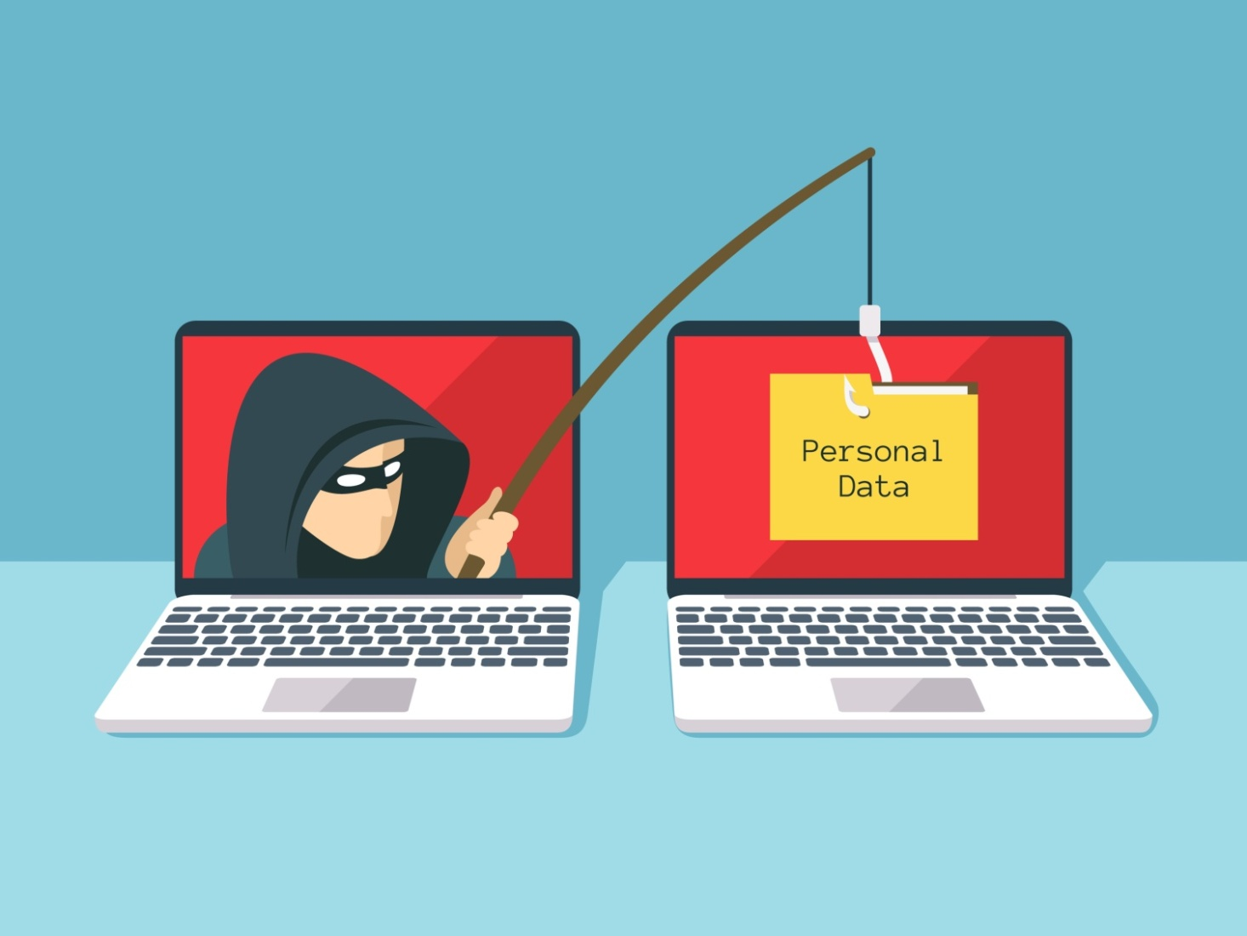
PHISHING

Slide 2

Meaning
Phishing is an online scam where attackers pretend to be a trusted person or company to trick you into giving them your personal information, like passwords or credit card numbers. They use fake emails, messages, or websites that look real to get you to click a link or provide sensitive data, which then goes straight to the scammer.

Slide 3
Deception:
The scammer sends a message that appears to be from a legitimate source, such as your bank, a social media site, or even a colleague.
Urgency:
The message often creates a sense of urgency, claiming your account is in danger or that you must act immediately to avoid a problem.
The Bait:
It will contain a link to a fake website that looks identical to the real one, or an attachment that, when opened, can download malware.
The Catch:
When you click the link and enter your information on the fake site, the data is sent directly to the criminal.
The Goal:
The ultimate goal is to steal your information to gain access to your accounts, steal your money, or commit identity theft.

Slide 4
Types of Phishing

Slide 5
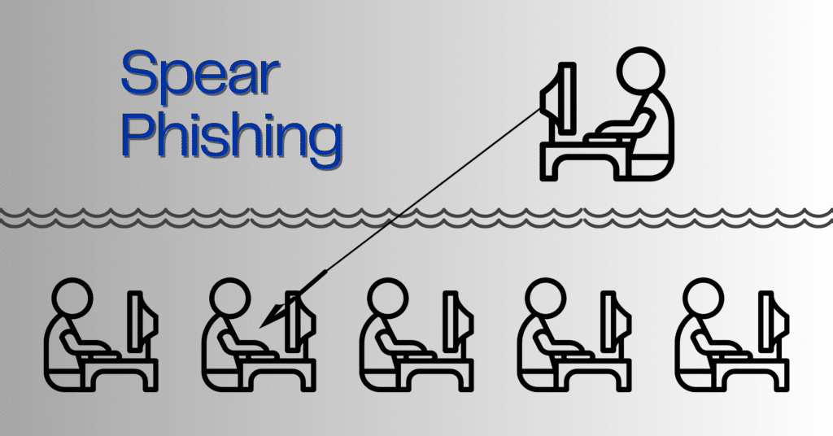
Spear phishing
What it is:
A highly personalized attack that targets a specific person or organization.
How it works:
Attackers use information gathered about the victim to make the fraudulent email or message seem more legitimate and trustworthy.

Slide 6

Whaling
What it is:
A type of spear phishing specifically targeting high-profile individuals like CEOs or other senior executives.
How it works:
Attackers impersonate senior management to trick employees into making unauthorized transactions or revealing sensitive company data.

Slide 7
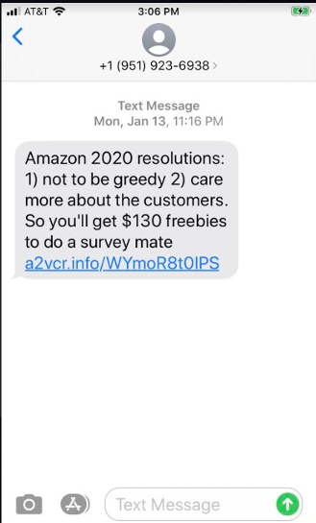
Smishing
What it is: Phishing that takes place via SMS (text messages).
How it works: Scammers send text messages that often contain a sense of urgency and a malicious link, prompting the user to click and provide information.

Slide 8
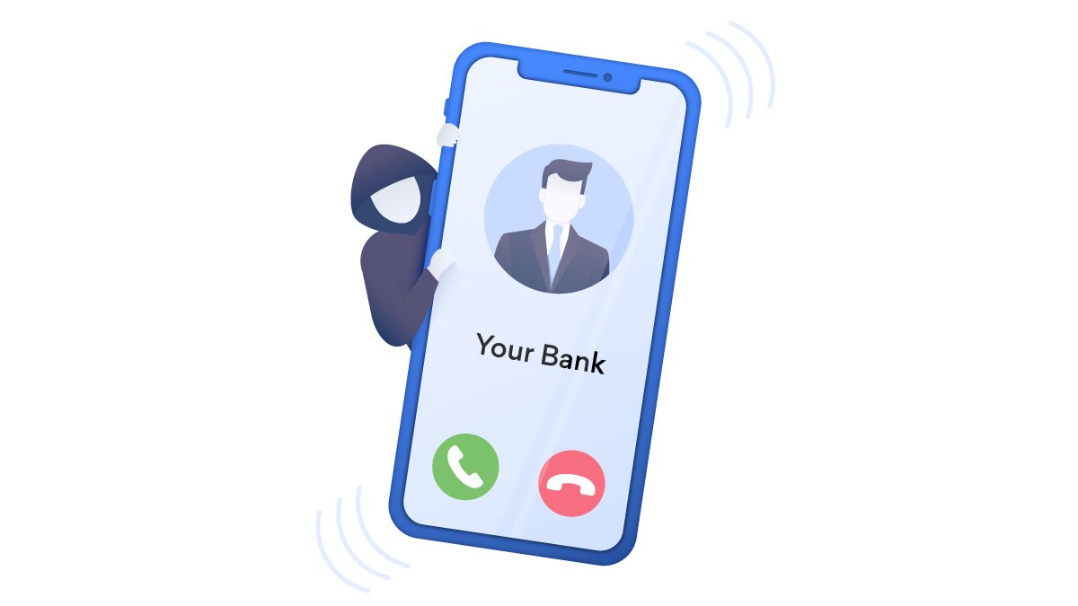
VISHING
What it is: Phishing that occurs over the phone, often through voice calls.
How it works: Attackers impersonate legitimate entities like banks or government agencies to convince the victim to divulge personal or financial information during a phone conversation.

Slide 9
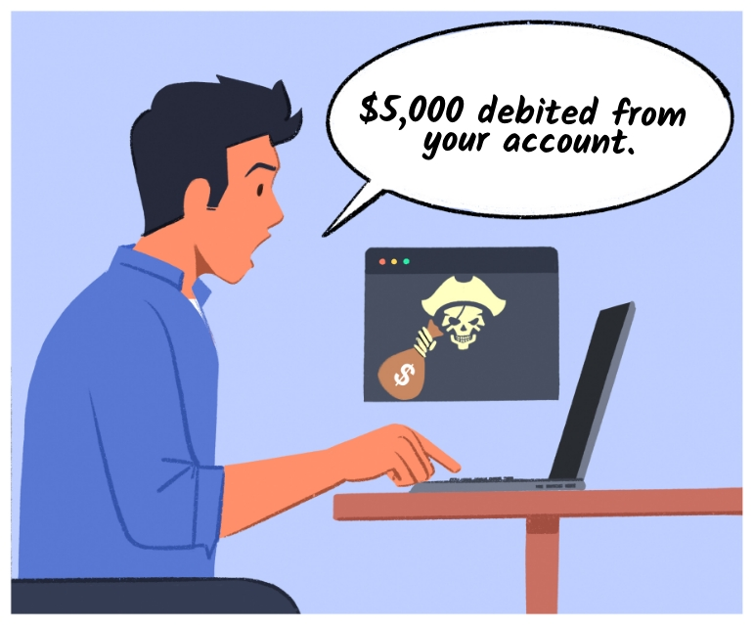
HOW do I know which website is phishing me ?

Slide 10
Here is the solution by gvm tech team
Relax and Click ME :-
https://chatgpt.com/canvas/shared/6924696e395c8191b6d8decdb1d33f6b

